Slide 1
CO1 - TECHNICAL PRESENTATION
Database Management Systems
Course Code: CSA0504
Name : SANTHOSH E
Reg No : 192511470

Slide 2
QUESTION 1 · ER MODELING
Entity-Relationship Diagrams: Core Concepts
ER Notation Legend
Entity — a real-world object with independent existence, drawn as a rectangle (e.g., BOOK, MEMBER)
ENTITY
1
Attribute — a property that describes an entity, drawn as an oval (e.g., Title, Email)
2
attribute
Relationship — an association between two or more entities, drawn as a diamond (e.g., BORROWS)
Relationship
3
Key Attribute — uniquely identifies each entity instance, shown underlined (e.g., Book_ID)
4
Weak Entity
Cardinality — defines participation ratio between entities: 1:1, 1:N, or M:N
5
02

Slide 3
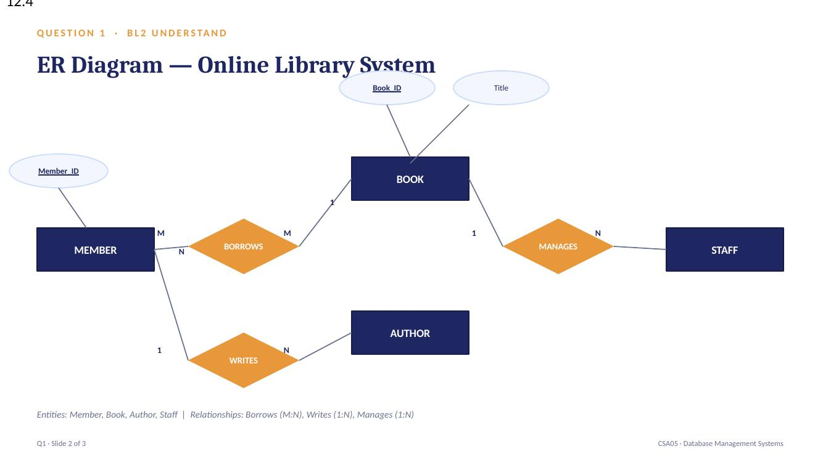


ER Diagram — Online Library System
QUESTION 1 · ER MODELING
AUTHOR
PUBLISHER
M
1
WRITES
N
N
PUBLISHES
BOOK
N
N
BORROWS
MANAGES
M
1
MEMBER
LIBRARIAN
03

Slide 4
Explaining the Library System Components
BOOK: key attribute Book_ID, with Title, ISBN, Genre and Copies_Available describing each title
1
MEMBER: key attribute Member_ID, with Name, Email and Membership_Type
2
BORROWS: an identifying M:N relationship linking Member and Book, carrying Issue_Date, Due_Date and Return_Date
3
AUTHOR (M:N via WRITES) and PUBLISHER (1:N via PUBLISHES) enrich Book with authorship and source details
4
LIBRARIAN manages Book records through the MANAGES relationship, ensuring accurate inventory tracking
5
04

Slide 5
QUESTION 2 · EER MODEL
Generalization & Specialization
Generalization: a bottom-up process that combines lower-level entities sharing common features into one higher-level superclass
PERSON
1
Specialization: a top-down process that divides a superclass into subclasses based on distinguishing characteristics
d
2
Attribute Inheritance: every subclass inherits all attributes and relationships of its superclass
STUDENT
FACULTY
3
Disjoint (d) vs Overlapping (o): an instance belongs to exactly one subclass (d), or possibly more than one (o)
Subclass hierarchy
(University case study →)
4
Total vs Partial Participation: total requires every superclass instance to belong to a subclass; partial does not
5
05

Slide 6
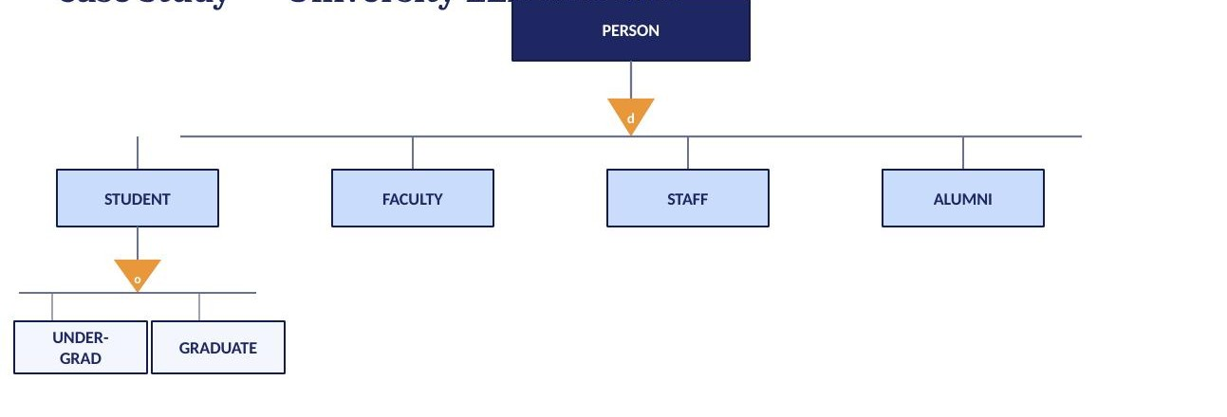



EER Diagram — University Case Study
QUESTION 2 · EER MODEL
PERSON
(Person_ID, Name, Address)
d
STUDENT
(Roll_No, Program, CGPA)
FACULTY
(Emp_ID, Dept, Designation)
STAFF
(Emp_ID, Role)
o
UNDER-
GRADUATE
POST-
GRADUATE
d = disjoint constraint (one subclass only) o = overlapping constraint (may belong to multiple)
06

Slide 7
Interpreting the University EER Diagram
PERSON is the superclass holding attributes common to every member of the university community
1
Specialization into STUDENT, FACULTY and STAFF uses a disjoint (d) constraint — each person belongs to exactly one subclass
2
Total participation ensures every PERSON instance is classified into one of the three subclasses; none remain unclassified
3
STUDENT is further specialized into UNDERGRADUATE and POSTGRADUATE with an overlapping (o) constraint for dual-enrolled students
4
Each subclass inherits Person_ID, Name and Address from PERSON while adding its own specific attributes
5
07

Slide 8
QUESTION 3 · DATA INDEPENDENCE
The Three-Schema Architecture
EXTERNAL LEVEL
User views / application interfaces
Mapping
CONCEPTUAL LEVEL
Community logical schema (entities, relationships, constraints)
Mapping
INTERNAL LEVEL
Physical storage — file structures, indexes, access paths
08

Slide 9
QUESTION 3 · DATA INDEPENDENCE
Logical vs. Physical Data Independence
Logical Data Independence
Physical Data Independence
Capacity to change the conceptual schema without altering external schemas or application programs
Capacity to change the internal (storage) schema without altering the conceptual schema
Protects applications from changes like adding a new attribute or entity
Protects the conceptual level from changes like new indexes or file reorganization
Harder to achieve — application logic is closely tied to logical structure
Easier to achieve — storage details are hidden beneath the conceptual layer
Example: adding a Membership_Type column to MEMBER without breaking existing programs
Example: switching Book records from sequential to indexed file storage transparently
09

Slide 10
QUESTION 3 · DATA INDEPENDENCE
Significance in DBMS Architecture
Shields application programs from underlying storage and structural changes, cutting maintenance effort and cost
1
Lets database administrators tune storage or indexing for performance without disrupting end users
2
Supports smooth schema evolution as organizational and business requirements grow over time
3
Improves portability, scalability, and long-term reliability of database-driven systems
4
Forms the theoretical foundation of the ANSI/SPARC three-schema architecture used across modern DBMS
5
10

Slide 11
QUESTION 4 · DBMS ARCHITECTURE
Software Components of a DBMS
USERS / APPLICATION PROGRAMS
QUERY PROCESSOR
STORAGE MANAGER
TRANSACTION MANAGER
DDL Interpreter · DML Compiler · Query Optimizer
Buffer Manager · File Manager
Concurrency Control · Recovery Manager
AUTHORIZATION & INTEGRITY MANAGER
DATABASE (Disk Storage)
11

Slide 12
Query Processor & Storage Manager
Query Processor interprets DML statements from users and converts them into low-level execution instructions
1
Its DDL Interpreter records schema definitions, while the DML Compiler translates queries into an evaluation plan
2
The Query Optimizer selects the most efficient execution strategy among equivalent plans
3
Storage Manager acts as the interface between application programs and data stored on disk
4
It comprises a Buffer Manager (manages in-memory data movement) and a File Manager (manages disk space allocation and file structures)
5
12

Slide 13
QUESTION 4 · DBMS ARCHITECTURE
Transaction Manager & Concurrency Control
Transaction Manager ensures every transaction satisfies the ACID properties: Atomicity, Consistency, Isolation, Durability
1
It coordinates concurrent execution of multiple transactions so results remain correct and conflict-free
2
The Concurrency Control component applies locking or timestamp-based protocols to prevent anomalies
3
The Recovery Manager restores the database to a consistent state after a crash, using transaction logs
4
Transaction Manager works closely with the Storage Manager to safely commit or roll back changes
5
13

Slide 14
QUESTION 5 · STRONG VS WEAK ENTITIES
Understanding Strong & Weak Entities
Strong Entity: has its own primary key and can exist independently (e.g., EMPLOYEE, ORDER)
STRONG
ENTITY
1
Weak Entity: has no primary key of its own; its existence depends on a related strong (owner) entity
2
Identifying
Relationship
Partial Key (Discriminator): distinguishes weak-entity instances that share the same owner, shown with a dashed underline
3
WEAK
ENTITY
Identifying Relationship: connects a weak entity to its owner; drawn as a double-outlined diamond
4
Notation: weak entity = double-outlined rectangle; identifying relationship = double-outlined diamond
5
14

Slide 15
Strong vs. Weak Entities — Comparison
Aspect
Strong Entity
Weak Entity
Primary key
Has its own primary key
No primary key; uses a partial key
Existence
Exists independently
Existence depends on owner entity
Notation
Single-outlined rectangle
Double-outlined rectangle
Relationship
Regular relationship (diamond)
Identifying relationship (double diamond)
Example
EMPLOYEE, ORDER
DEPENDENT, ORDER_ITEM
15

Slide 16
QUESTION 5 · STRONG VS WEAK ENTITIES
Real-World Examples
ORDER
HAS
ORDER_ITEM
ORDER_ITEM cannot exist without its parent ORDER — deleting the order removes its line items too
1
Partial key: Item_Line_No
DEPENDENT records (e.g., a child or spouse) only make sense in the context of an EMPLOYEE
2
EMPLOYEE
HAS
DEPENDENT
Partial key: Dependent_Name
16

Slide 17
THANK YOU

